Slide 1
Chapter 2
Modeling Complex Systems

Slide 2
CONTENTS
2.1 Introduction
2.2 List Processing in Simulation
2.3 A Simple Simulation Language: simlib
2.4 Single-Server Queueing System with simlib
2.5 Time-Shared Computer Model
2.6 Multiteller Bank with Jockeying
2.7 Job-Shop Model
2.8 Efficient Event-List Manipulation

Slide 3
2.1 INTRODUCTION
Complex systems usually require complex models – difficult to code from scratch in general-purpose language
Need some help, more simulation-oriented software
In this chapter, will discuss list processing, a central activity in most simulations (and high-level simulation software)
Develop and illustrate a set of support routines, simlib, that does several “routine” simulation tasks
  List processing, event-list management, random-number and variate generation, statistics collection, output reporting
  Will do this in C … FORTRAN codes available on book’s website
simlib is not a “real” real simulation language
  Doing it here to illustrate what’s behind commercial simulation software, enable modeling of more complex systems

Slide 4
2.2 LIST PROCESSING IN SIMULATION
Most simulations involve lists
  Queues, event list, others
  A list is composed of records
Record: Usually corresponds to an object in the list
  By convention, a record is represented as a row in a two-dimensional array (matrix) representing the list
  A person in a queue list, an event in the event list
  A record is composed of one or more attributes
Attribute: A data field of each record
  By convention, attributes are in columns
  Examples of records (lines) of attributes (columns):
    Queue list: [time of arrival, customer type, service requirement, priority, …]
    Event list: [event time, event type, possibly other attributes of the event]

Slide 5
2.2.1 Approaches to Storing Lists in a Computer
Sequential allocation – approach used in Chap. 1
  Records are in physically adjacent storage locations in the list, one record after another
  Logical position = physical position
Linked allocation
  Logical location need not be the same as physical location
  Each record contains its usual attributes, plus pointers (or links)
    Successor link (or front pointer) – physical location (row number) of the record that’s logically next in the list
    Predecessor link (or back pointer) – physical location of the record that’s logically before this one in the list
  Each list has head pointer, tail pointer giving physical location of (logically) first and last records

Slide 6
2.2.1 Approaches to Storing Lists in a Computer (cont’d.)
Advantages of linked over sequential allocation
  Adding, deleting, inserting, moving records involves far fewer operations, so is much faster … critical for event-list management
    Sequential allocation – have to move records around physically, copying all the attributes
    Linked allocation – just readjust a few pointers, leave the record and attribute data physically where they are
  Reduce memory requirements without increasing chance of list overflow
    Multiple lists can occupy the same physical storage area … can grow and shrink more flexibly than if they have their own storage area
  Provides a general modeling framework for list processing, which composes a lot of the modeling, computing in many simulations

Slide 7
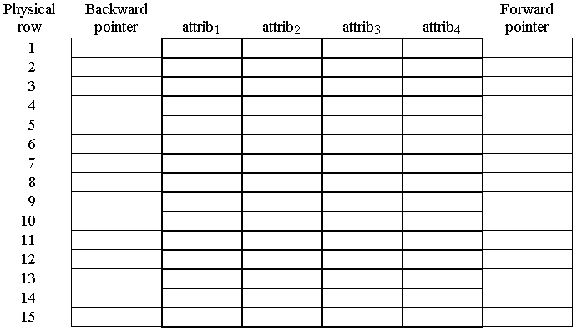
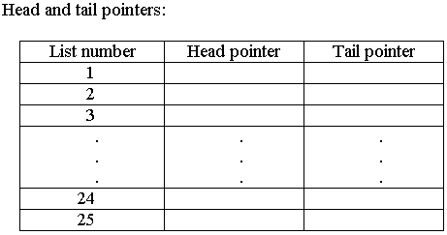
2.2.2 Linked Storage Allocation
Will treat doubly-linked lists (could define singly-linked)
Physical storage area for all lists (max of, say, 25 lists)
  Array with (say) 15 rows, 4 columns for attributes, a column for back pointers, a column for forward pointers
  Also need array with 25 rows, 2 columns for head and tail pointers of each list

Slide 8
2.2.2 Linked Storage Allocation (cont’d.)
Example: Two queues (FIFO, Shortest-Job-First), event list (see text for different examples)
  FIFO queue: attrib₁ = time of arrival
  SJF queue: attrib₁ = time of arrival, attrib₂ = service requirement; insert new records (customers) to keep list ranked in increasing order on attrib₂; remove next customer to serve off top of list
  Event list: attrib₁ = (future) event time, attrib₂ = event type

Slide 9
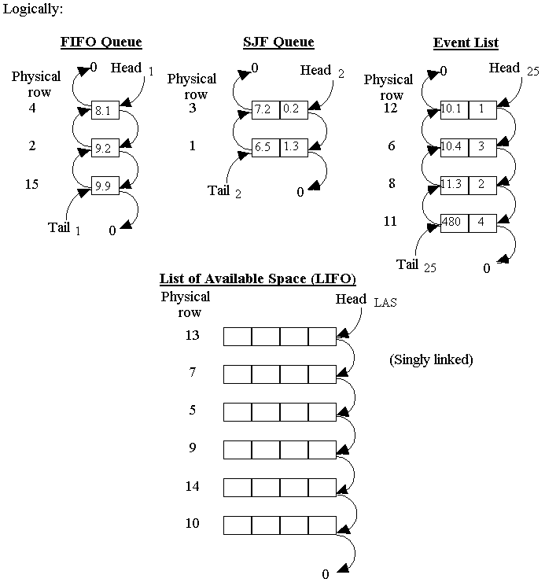
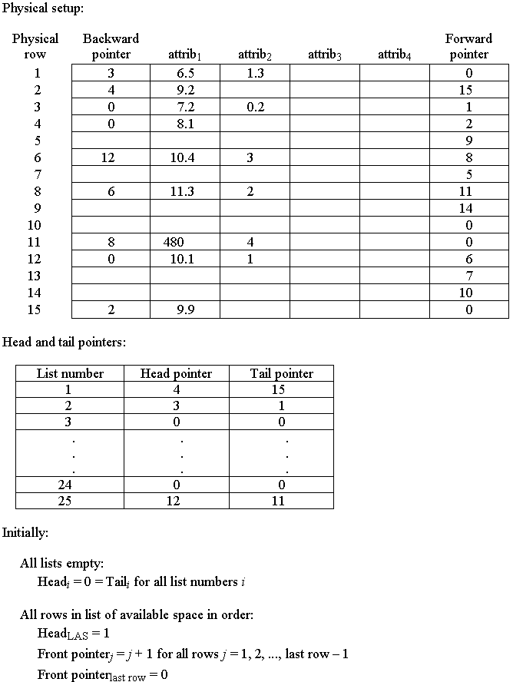
2.2.2 Linked Storage Allocation (cont’d.)
Need: Utility code
to manage all this …

Slide 10
2.3 A SIMPLE SIMULATION LANGUAGE: simlib
Some C functions – rudimentary simulation “language”
  Source code in Appendix 2A, and on book’s website
  Also available in “legacy” FORTRAN on book’s website
Capabilities
  List processing (pointers, file a record, remove a record)
  Processes event list
  Tallies statistical counters
  Generate random numbers, variates from some distributions
  Provide “standard” output (optional)
Not a “real” simulation language – incomplete, inefficient
  But illustrates what’s in real simulation software, how it works

Slide 11
2.3 A Simple Simulation Language: simlib (cont’d.)
Heart of simlib is a collection of doubly linked lists
  All live together in dynamic memory – space allocated as new records are filed in lists, freed when records are removed from lists
  Maximum of 25 lists
  Records in lists can have a maximum of 10 attributes
  Data are stored as type float
  Uses dynamic storage allocation, so total number of records in all lists is limited only by hardware
  List 25 always reserved for event list
    Always: attribute 1 = (future) event time, attribute 2 = event type
    attributes 3-10 can be used for other event attributes
    Kept sorted in increasing order on event time – next event is always on top
User must #include simlib.h for required declarations, definitions
  simlib.h in turn #includes simlibdefs.h

Slide 12
2.3 A Simple Simulation Language: simlib (cont’d.)
Key simlib variables and constants
  sim_time = simulation clock; updated by simlib
  next_event_type = type of next event; determined by simlib
  transfer[i]: float array indexed on i = 1, 2, …, 10 for transferring attributes of records into and out of lists
  maxatr = max number of attributes in any list; defaults to 10, but user can initialize to < 10 for improved efficiency (cannot be set to < 4 due to the way simlib works)
  list_size[list] = current number of records in list list; maintained by simlib
  list_rank[list] = attribute number (if any) on which list list is to be ranked (incr. or decr.); must be initialized by user
  FIRST, LAST, INCREASING, DECREASING: symbolic constants for options of filing a record into a list
  LIST_EVENT, EVENT_TIME, EVENT_TYPE: symbolic constants for event-list number, attribute number of event time, attribute number of event type

Slide 13
2.3 A Simple Simulation Language: simlib (cont’d.)
Description of the 19 functions in simlib:
  init_simlib: Invoke at beginning of each simulation run from the (user-written) main function to allocate storage for lists, initialize all pointers, set clock to 0, sets event list for proper ranking on event time, defaults maxatr to 10, sets all statistical counters to 0
  list_file(option, list): File a record (user must pre-load attributes into transfer array) in list list, according to option:
    1 or FIRST File record as the new beginning of the list
    2 or LAST File record as the new end of the list
    3 or INCREASING File record to keep list in increasing order on
    attribute list_rank[list] (as pre-set by user)
    4 or DECREASING File record to keep list in increasing order on
    attribute list_rank[list]

Slide 14
2.3 A Simple Simulation Language: simlib (cont’d.)
  list_remove(option, list): Remove a record from list list and copy its attributes into the transfer array, according to option:
    1 or FIRST Remove the first record from the list
    2 or LAST Remove the last record from the list
  timing: Invoke from main function to remove the first record from the event list (the next event), advance the clock to the time of the next event, and set next_event_type to its type; if attributes beyond 1 and 2 are used in the event list their values are copied into the corresponding spots in the transfer array
  event_schedule(time_of_event, type_of_event): Invoke to schedule an event at the indicated time of the indicated type; if attributes beyond 1 and 2 are used in the event list their values must be pre-set in the transfer array

Slide 15
2.3 A Simple Simulation Language: simlib (cont’d.)
  event_cancel(event_type): Cancel (remove) the first (most imminent) event of type event_type from the event list, if there is one, and copy its attributes into the transfer array
  sampst(value, variable): Accumulate and summarize discrete-time process data
    Can maintain up to 20 separate “registers” (sampst variables); 3 functions:
      During the simulation: record a value already placed in value in sampst variable variable: sampst (value, variable)
      At end of simulation: invoke sampst with the negative of the variable desired (value doesn’t matter); get in transfer array the mean (1), number of observations (2), max (3), min (4); name sampst also has mean
      To reset all sampst variables: sampst (0.0, 0); normally done at initialization, but could be done at any time during the simulation

Slide 16
2.3 A Simple Simulation Language: simlib (cont’d.)
  timest(value, variable): Accumulate and summarize continuous-time process data
    Can maintain up to 20 separate “registers” (timest variables), separate from sampst variables; 3 functions:
      During the simulation: record a new value (after the change in its level) already placed in value in timest variable variable:
      timest (value, variable)
      At end of simulation: invoke timest with the negative of the variable desired (value doesn’t matter); get in transfer array the mean (1), max (2), min (3); name timest also has mean
      To reset all timest variables: timest (0.0, 0); normally done at initialization, but could be done at any time during the simulation
  filest(list): Produces summary statistics on number of records in list list up to time of invocation
    Get in transfer array the mean (1), max (2), min (3) number of records in list list; name filest also has mean
    Why? List lengths can have physical meaning (queue length, server status)

Slide 17
2.3 A Simple Simulation Language: simlib (cont’d.)
  out_sampst(unit, lowvar, highvar): Write to file unit summary statistics (mean, number of values, max, min) on sampst variables lowvar through highvar
    Get “standard” output format, 80 characters wide
    Alternative to final invocation of sampst (still must initialize and use sampst along the way)
  out_timest(unit, lowvar, highvar): Like out_sampst but for timest variables
  out_filest(unit, lowfile, highfile): Like out_sampst but for summary statistics on number of records in lists lowfile through highfile

Slide 18
2.3 A Simple Simulation Language: simlib (cont’d.)
  expon(mean, stream): Returns in its name a variate from an exponential distribution with mean mean, using random-number “stream” stream (more on streams in Chaps. 7, 11)
    Uses random-number generator lcgrand (see below, and Chap. 7)
  random_integer(prob_distrib[], stream): Returns a variate from a discrete probability distribution with cumulative distribution in the array prob_distrib, using stream stream
    Assumes range is 1, 2, …, k, with k ≤ 25
    User prespecifies prob_distrib[i] to be P(X ≤ i) for i = 1, 2, …, k
    Note that prob_distrib[k] should be specified as 1.0
  uniform(a, b, stream): Returns a variate from a continuous uniform distribution on [a, b], using stream stream
  erlang(m, mean, stream): Returns a variate from an
  m-Erlang distribution (see below, and Chaps. 6, 8) with mean mean, using stream stream

Slide 19
2.3 A Simple Simulation Language: simlib (cont’d.)
  lcgrand(stream): Random-number generator, returns a variate from the (continuous) U(0, 1) distribution, using stream stream
    See Chap. 7 for algorithm, code
    stream can be 1, 2, …, 100
    When using simlib, no need to #include lcgrand.h since simlib.h, already #included, has the definitions needed for lcgrand
  lcgrandst(zset, stream): Sets
  the random-number “seed” for stream
  stream to zset
  lcgrandgt(stream): Returns the
  current underlying integer for stream
  stream
See Chap. 7 for details
Use – at end of a run, use lcgrandgt to get the current underlying integer
Use this value as zset in lcgrandst for a later run that will be the same as extending the earlier run

Slide 20
2.3 A Simple Simulation Language: simlib (cont’d.)
Using simlib
  Still up to user to determine events, write main function and event functions (and maybe other functions), but simlib functions makes this easier
  Determine what lists are needed,
  what their attributes are
  Determine sampst, timest
  variables
  Determine and assign usage of
  random-number streams
  simlib variables take the place of many state, accumulator variables, but user may still need to declare some global or local variables
Numbering is largely arbitrary, but it’s essential to:
Decide ahead of time
Write it all down
Be consistent

Slide 21
2.3 A Simple Simulation Language: simlib (cont’d.)
Typical activities in the user-written main function (roughly, but not necessarily exactly, in this order):
  Read/write input parameters
  Invoke init_simlib to initialize simlib’s variables
  (Maybe) Set lrank_list[list] to attribute number for ranked lists
  (Speed option) Set maxatr to max number of attributes per list
  (Maybe) timest to initialize any timest variables to nonzero values
  Initialize event list via event_schedule for each event scheduled at time 0
    If using more than first two attributes in event list (time, type), must set transfer[3], transfer[4], … before invoking event_schedule
    Events not initially to be scheduled are just left out of the event list
  Invoke timing to determine next_event_type and advance clock
  Invoke appropriate event function, perhaps with case statement
  At end of simulation, invoke user-written report generator that usually uses sampst, timest, filest, out_sampst, out_timest, out_filest

Slide 22
2.3 A Simple Simulation Language: simlib (cont’d.)
Things to do in your program
  Maintain lists via list_file, list_remove, together with transfer to communicate attribute data to and from lists
  Gather statistics via sampst and timest
  Update event list via event_schedule
Error checking – cannot check for all kinds of errors, but some opportunities to do some things in simulation “software” – so simlib checks/traps for:
  Time reversal (scheduling an event to happen in the past)
  Illegal list numbers, variable numbers
  Trying to remove a record from an empty list

Slide 23
2.4 SINGLE-SERVER QUEUEING SIMULATION WITH simlib;
2.4.1 Problem Statement;
2.4.2 simlib Program
Same model as in Chap. 1
  Original 1000-delay stopping rule
  Same events (1 = arrival, 2 = departure)
simlib lists, attributes:
  1 = queue, attributes = [time of arrival to queue]
  2 = server, no attributes (dummy list for utilization)
  25 = event list, attributes = [event time, event type]
sampst variable: 1 = delays in queue
timest variables: none (use filest or out_filest)
Random-number streams:
1 = interarrivals, 2 = service times

Slide 24
2.4.2 simlib Program (cont’d.);
2.4.3 Simulation Output and Discussion
Refer to pp. 124-129 in the book (Figures 2.6-2.12) and the file mm1smlb.c
  Figure 2.6 – external definitions (at top of file)
  Figure 2.7 – function main
  Figure 2.8 – function init_model
  Figure 2.9 – function arrive
  Figure 2.10 – function depart
  Figure 2.11 – function report
  Figure 2.12 – output report mm1smlb.out
    Results differ from Chap. 1 (same model, input parameters, start/stop rules) – why?

Slide 25
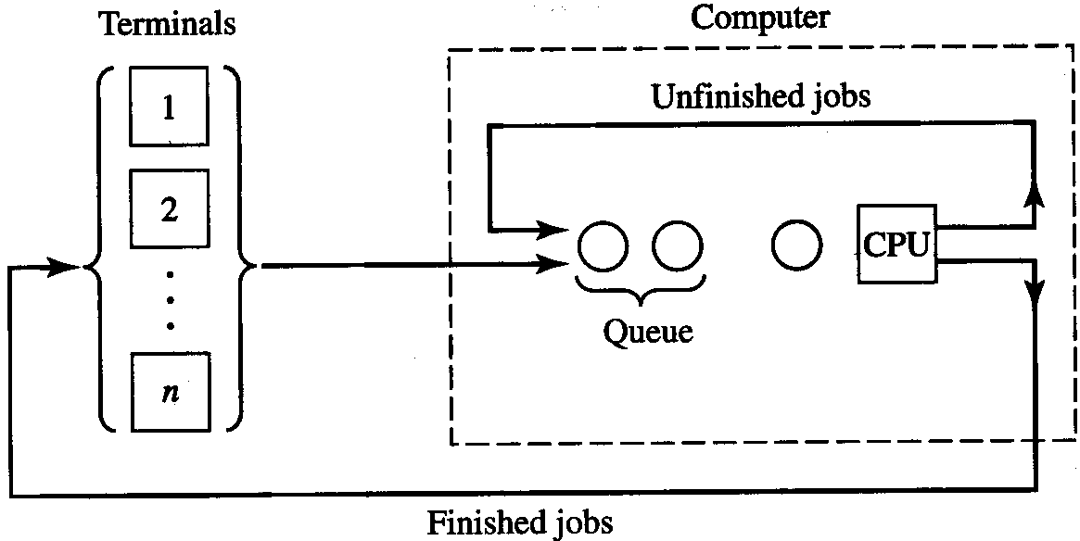
2.5 TIME-SHARED COMPUTER MODEL;
2.5.1 Problem Statement
Think times of jobs at terminals:
Expon (mean = 25 sec.)
Processing times of jobs at CPU:
Expon (mean = 0.8 sec.)
Fixed number of terminals (and jobs), n
Processing rule: round-robin
  Each visit to CPU is ≤ q = 0.1 sec. (a quantum)
    If job still needs > q sec., it gets q sec, then kicked out
    If job still needs ≤ q sec., it gets what it needs, returns to its terminal
  Compromise between extremes of FIFO (q = ∞) and SJF (q = 0)
Swap time: τ = 0.15 sec. Elapse whenever a job enters CPU before processing starts
Response time of a job = (time job returns to terminal) – (time it left its terminal)

Slide 26
2.5.1 Problem Statement (cont’d.)
Initially, computer empty and idle, all n jobs in the think state at their terminals
Stopping rule: 1000 response times collected
Output:
  Average of the response times
  Time-average number of jobs in queue for the CPU
  CPU utilization
Question: how many terminals (n) can be loaded on and hold average response time to under 30 sec.?

Slide 27
2.5.2 simlib Program
Events
  1 = Arrival of a job to the computer (at end of a think time)
  2 = A job leaves the CPU (done or kicked out)
  3 = End simulation (scheduled at time 1000th job gets done, for now)
  (Also, have “utility” non-event function start_CPU_run to remove first job from queue, put it into the CPU)
simlib lists, attributes:
  1 = queue, attributes = [time of arrival of job to computer,
  remaining service time]
  2 = CPU, attributes = [time of arrival of job to computer,
  remaining service time]
    In CPU, if remaining service time > 0 then job has this much CPU time needed after current CPU pass; if remaining service time ≤ 0, job will be done after this pass
  25 = event list, attributes = [event time, event type]

Slide 28
2.5.2 simlib Program (cont’d.);
2.5.3 Simulation Output and Discussion
sampst variable: 1 = response times
timest variables: none (use filest or out_filest)
Random-number streams:
1 = think times, 2 = service times
Refer to pp. 133-141 in the book (Figures 2.15-2.24) and the file tscomp.c
  Figure 2.15 – external definitions (at top of file)
  Figure 2.16 – function main
  Figure 2.18 – function arrive (flowchart: Figure 2.17)
  Figure 2.20 – function start_cpu_run (flowchart: Figure 2.19)
  Figure 2.22 – function end_cpu_run (flowchart: Figure 2.21)
  Figure 2.23 – function report
  Figure 2.24 – output report tscomp.out
    Looks like max n is a little under 60 – sure?

Slide 29
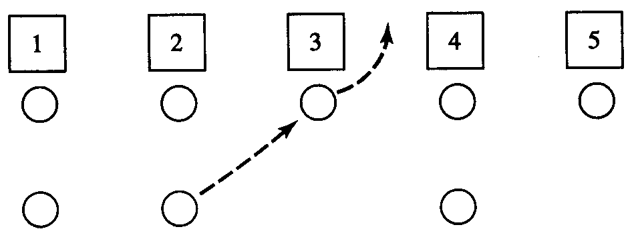
2.6 MULTITELLER BANK W/ JOCKEYING;
2.6.1 Problem Statement
Service times:
Expon (mean = 4.5 min.)
Interarrival times:
Expon (mean = 1 min.)
New arrivals:
  If there’s an idle teller, choose leftmost (idle) teller
  If all tellers are busy, choose shortest queue (ties – leftmost)
Initially empty and idle
Termination: close doors at time 480 min.
  If all tellers are idle at that time, stop immediately
  If any tellers are busy, operate until all customers leave service

Slide 30
2.6.1 Problem Statement (cont’d.)
Jockeying (line-hopping) rules
  Suppose teller i (i fixed) finishes service — e.g., i = 3 above
  Then either teller i becomes idle, or queue i becomes one shorter
  Maybe a customer at the end of some other queue j (≠ i) moves to teller i (if now idle) or the the end of the now-shorter queue i
  For each teller/queue k, let n_{k} = number of customers facing (in queue + in service) teller k just after teller i finishes service
  Procedure:
    If n_{j} > n_{i} + 1 for some j ≠ i, then a jockey will occur
    If n_{j} > n_{i} + 1 for several values of j ≠ i, pick the closest j (min |j – i|)
    If n_{j} > n_{i} + 1 for two equally closest (left and right) values of j ≠ i, pick the left (smaller) value of j
Estimate
  Time-average total number of customers in (all) queues
  Average, max delay of customers in queue(s)
Question: What’s the effect of the number of tellers (4-7)?

Slide 31
2.6.2 simlib Program
Events
  1 = Arrival of a customer to the bank
  2 = Departure of a customer from a teller (need to know which teller)
  3 = Close doors at time 480 min. (may or may not be The End)
  (Also, have “utility” non-event function jockey to see if anyone wants to jockey, and, if so, carry it out)
simlib lists, attributes (n = number of tellers):
  1, …, n = queues, attributes = [time of arrival to queue]
  n + 1, …, 2n = tellers, no attributes = (dummy lists for utilizations)
  25 = event list, attributes = [event time, event type,
  teller number if event type = 2]
sampst variable: 1 = delay of customers in queue(s)

Slide 32
2.6.2 simlib Program ;
2.6.3 Simulation Output and Discussion
timest variables: none … use filest for time-average number in queues since time-average of total = total of time averages (details in book)
Random-number streams:
1 = interarrival times, 2 = service times
Refer to pp. 145-155 in the book (Figures 2.27-2.36) and the file mtbank.c
  Figure 2.27 – external definitions (at top of file)
  Figure 2.28 – function main
  Figure 2.30 – function arrive (flowchart: Figure 2.29)
  Figure 2.32 – function depart (flowchart: Figure 2.31)
  Figure 2.34 – function jockey (flowchart: Figure 2.33)
  Figure 2.35 – function report
  Figure 2.36 – output report mtbank.out
    Looks like 4 tellers would be a disaster, 6 might be worth it, 7 not (sure?)

Slide 33
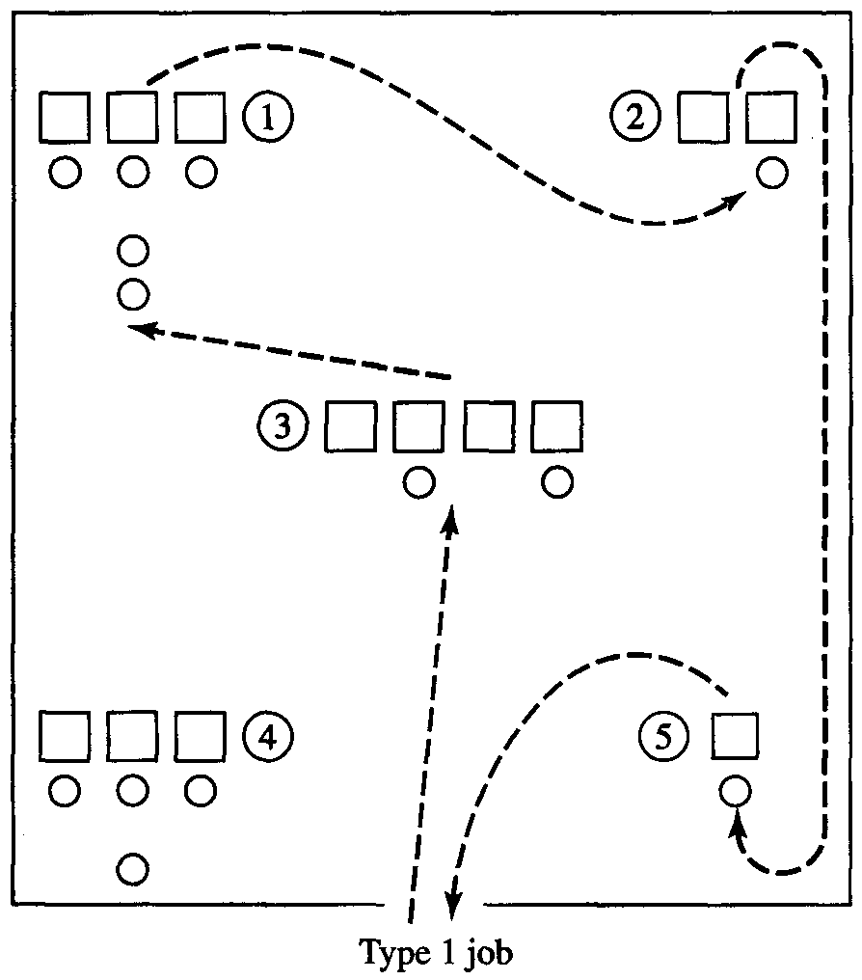
2.7 JOB-SHOP MODEL;
2.7.1 Problem Statement
Five workstations
  Number of identical machines at each workstation as shown
  Network of multiserver queues
Three types of jobs
  Interarrival times (all job types combined) expon (mean = 0.25 hour)
  Job type determined just after arrival
    Type 1, 2, 3 w.p. 0.3, 0.5, 0.2
  Workstation routes for job types:
    Type 1: 3 → 1 → 2 → 5 (shown at left)
    Type 2: 4 → 1 → 3
    Type 3: 2 → 5 → 1 → 4 → 3
  Mean service times (2-Erlang distrib.):
    Type 1: 0.50 → 0.60 → 0.85 → 0.50
    Type 2: 1.10 → 0.80 → 0.75
    Type 3: 1.20 → 0.25 → 0.70 → 0.90 → 1.0
Initially empty and idle
Stop at time 365 × 8 hours

Slide 34
2.7.1 Problem Statement (cont’d.)
Estimate
  Average total delay in queues for each job type separately
  Overall average total delay in queues over all job types, weighted by their (known) probabilities of occurrence
    Why not just average the total delay in queues over all the jobs that show up and get through?
  For each machine group separately:
    Average delay in queue there (all job types lumped together)
    Time-average number of jobs in queue (all job types together)
    Group utilization =
    Number of machines in the group
Question: If you could add one machine to the shop, to which group should it go?
Time-average number of machines that are busy
Number of machines in the group

Slide 35
2.7.2 simlib Program
Events
  1 = Arrival of a job to the system
  2 = Departure of a job from a particular station
  3 = End of the simulation
simlib lists, attributes:
  1, …, 5 = queues, attributes = [time of arrival to station,
  job type, task number]
  25 = event list, attributes = [event time, event type,
  job type (if event type = 2),
  task number (if event type = 2)]
  (Task number of a job is how far along it is on its route, measured in stations, so starts at 1, then is incremented by 1 for each station)

Slide 36
2.7.2 simlib Program (cont’d.)
sampst variables:
  1, …, 5, = delay in queue at machine group 1, …, 5
  6, 7, 8 = total delay in queues for job type 1, 2, 3
timest variables:
  1, …, 5 = number of machines busy at machine group 1, …, 5
  (We’ll keep our own, non-simlib variable num_machines_busy[j] to track the number of machines busy in group j)
Random-number streams: 1 = interarrival times,
2 = job-type coin flip, 3 = service times

Slide 37
2.7.2 simlib Program (cont’d.);
2.7.3 Simulation Output and Discussion
Refer to pp. 160-169 in the book (Figures 2.39-2.46) and the file jobshop.c
  Figure 2.39 – external definitions (at top of file)
  Figure 2.40 – function main
  Figure 2.42 – function arrive (flowchart: Figure 2.41)
    Note that arrive serves two purposes – new arrival event, “arrival” of an “old” job to its next machine group
  Figure 2.44 – function depart (flowchart: Figure 2.43)
    Note that depart (and this function) is the event of leaving a particular machine group, which may or may not be the end of the road for a job
  Figure 2.45 – function report
  Figure 2.46 – output report mtbank.out
    Looks like congested machine groups are 1, 2, and 4 (sure?)
    Reruns with extra machine at each of these in turn – add machine to 4 (?)

Slide 38
2.8 EFFICIENT EVENT-LIST MANIPULATION
Have seen two different ways to store, handle the event list
  Sequential by event type – search for smallest entry for next event
    Must always look at the whole event list
  Ranked in increasing order by event time – insert correctly, take next event from top
    Event insertion might not require looking at the whole list
In large simulations with many events, event-list processing can consume much of the total computing time (e.g., 40%)
  Generally worth it to try hard to manage the event list efficiently
  Better methods – binary search, storing event list as a tree or heap
  Exploit special structure of model to speed up event-list processing
    e.g., if time a record stays on event list is approximately the same for all events, insert a new event via a bottom-to-top search

